Slide 1


MRM Traffic Network Data Hub
for Performing DTA Analysis
ASU Transportation+AI team

Slide 2
List of Essential Data Files and Executables
External input file | GMNS input file | Output of DTALite
1a. Node shape file | 2a. node.csv | 5a. link_performance.csv
1b. Link shape file | 2b. link.csv | 5b. od_accessibility.csv 5c.route_assignment.csv
1c. Zone shape file (optional) | 2c. zone.csv | 5d. final_summary.csv
3. Demand file (csv, matrix) | 4. setting.csv demand_file_list and departure time profile | 6a. Agent file 6b. trajectory.csv from simulation
2c. If node.csv contains zone id, then zone.csv is optional

Slide 3
List of Essential Data Files and Executables
Executable lists | Python packages
1a. DTALite.exe, https://github.com/asu-trans-ai-lab/DTALite | 2a. osm2gmns, https://pypi.org/project/osm2gmns/
1b. NeXTA.exe, https://github.com/asu-trans-ai-lab/NeXTA4GMNS | 2b. signal4gmns, https://github.com/asu-trans-ai-lab/signal4gmns
 | 2c. trace2route, https://github.com/asu-trans-ai-lab/MapMatching4GMNS
 | 2d. gtfs2gmns, https://github.com/asu-trans-ai-lab/GTFS2GMNS
2a. osm2gmns package is to generate multi-resolution networks.
2b. signal4gmns package is to update signal timing of mesoscopic and microscopic network.
2c. trace2route package is to map matching
2d. gtfs2gmns package is to convert GTFS data to GMNS network

Slide 4
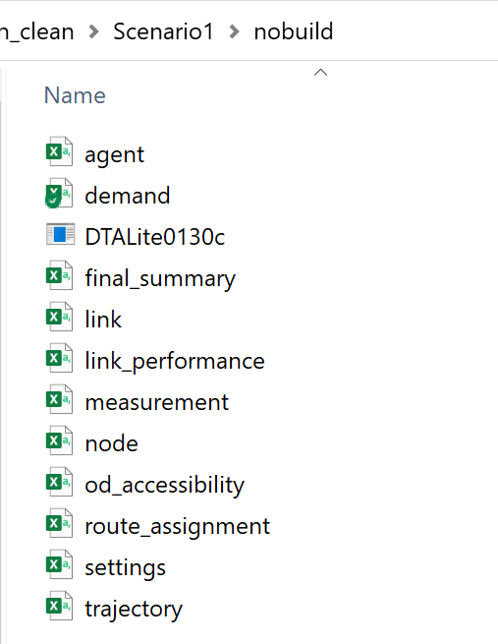
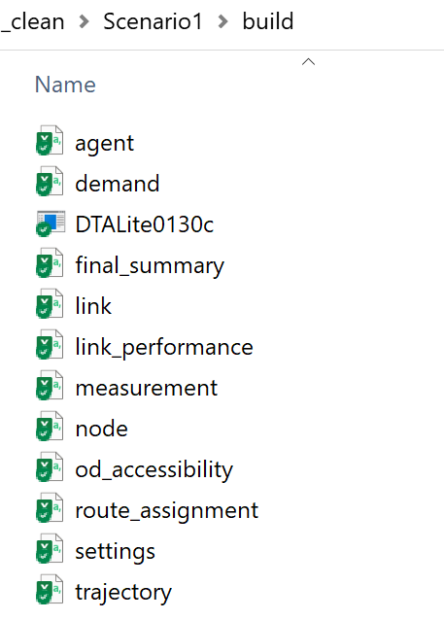
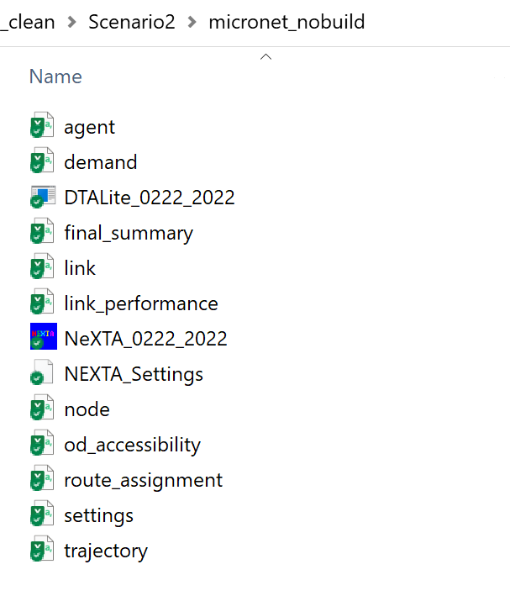
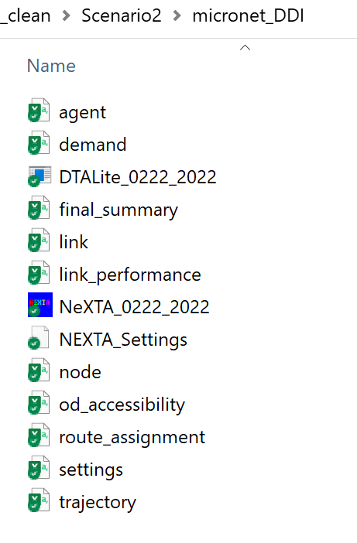
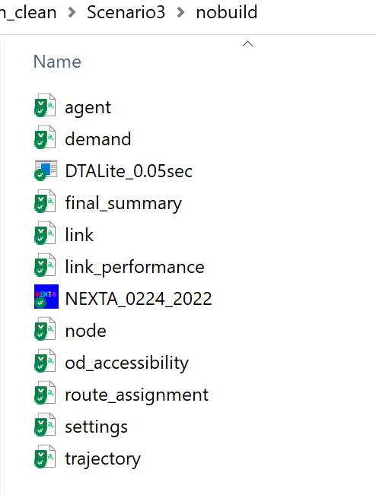
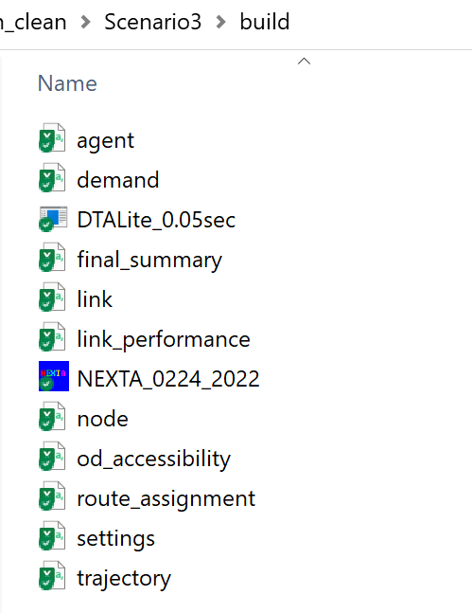
Screenshot of File folders
Scenario 1
Scenario 2
Scenario 3

Slide 5
0.Data Flow of Applying Data Hub Implementation
Original Data Files
Core Input Files + Engines
Core Output Files
GIS Import Config
GIS Node/Link/Zone/Connector Shape Files
NeXTA
Node/Link/Zone
Demand Type/ Vehicle Type
Work zone/ VMS scenarios
Demand meta database file
Time-dependent Link MOE
Demand Matrix Files
DTALite
Agent Trajectory
signal4gmns Package
Simulation Result Summary
Signal Control Files
Movement/
signal timing
Notes:
This data flow gives the system importing, analysis and exporting data flow for the bundle of DTALite and NEXTA. In particular, our solution to import GIS data from multiple planning packages is to develop an open data format that allows DTALite users to feasibly convert their own data in proprietary format to a unifying data structure and widely used longitude and latitude coordinate system (WGS 84 used by Google Maps, Google Earth and on-line Google Fusion Tables).
In the third step of important data, we use meta data definitions for network and demand files, which can avoid ad-hoc linkages to specific software packages. By integrating a Quick Estimation Method (QEM) as a solid signal control emulator that can provide realistic signal timing and phasing data, we simplify the data preparation process for signalized intersections.
Furthermore, the open-source NEXTA package, as a network editing and visualization tool, is made available through this project to display large-scale dynamic traffic analysis results. It plays a critical role for both validating and reporting operational performance at different bottlenecks.

Slide 6
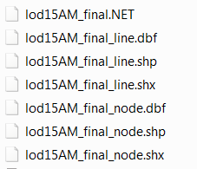
1. Prepare Required Shape files (1a,1b,1c)
Usually, those shape files are from static regional travel model (Cube,
TransCAD, VISSUM, etc.) They are node shape file (1a), link shape file (1b)
and zone shape file (1c).
Zone shape file is optional.
e.g. given shape files
node.shp:
provide node ID and coordinate values;
line.shp:
provide from node id, to node id, length of links, link type, number of lanes

Slide 7
2. Extract GIS information from shape files to GMNS files
Import_GIS_settings.csv

Slide 8
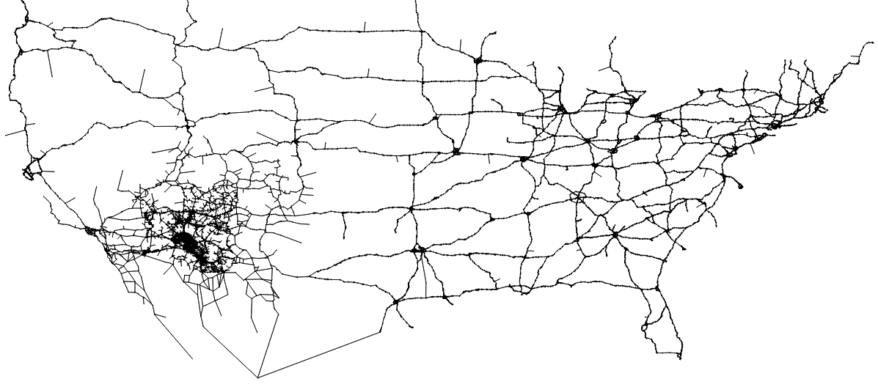
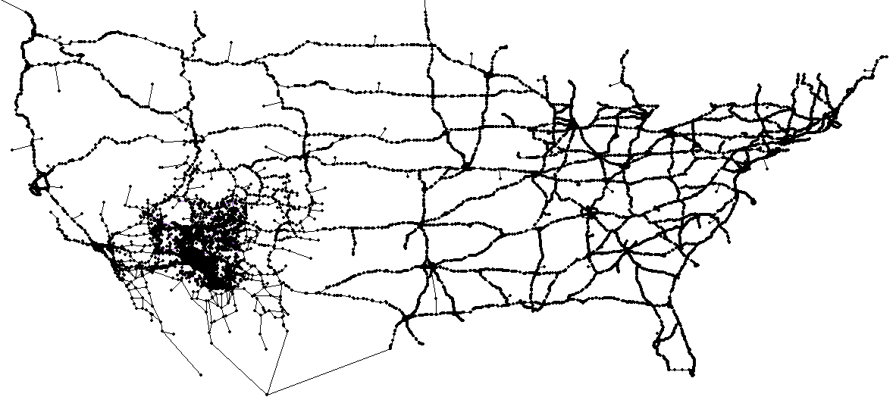
Compare the generated network with that from shape file for final check.
GIS Shape files
NeXTA

Slide 9
3. Demand file management
Demand file (3) is the source of dynamic traffic assignment. Generally, it is provided by users. As a data hub, NeXTA can accommodate various demand formats, such as,
column format
matrix format,
agent file,

Slide 10
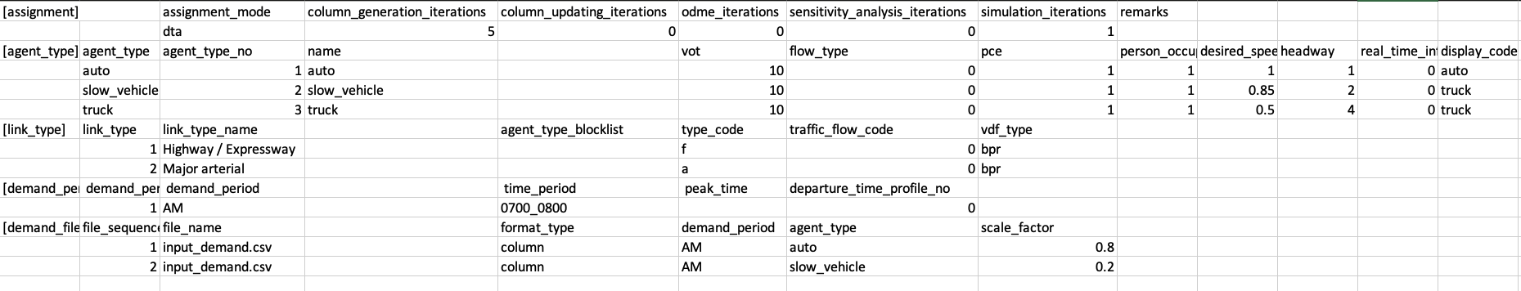
4. Settings.csv
The settings.csv file (4) is used to setup the reading list of demand data (3), and to define the departure time profile.
settings.csv

Slide 11
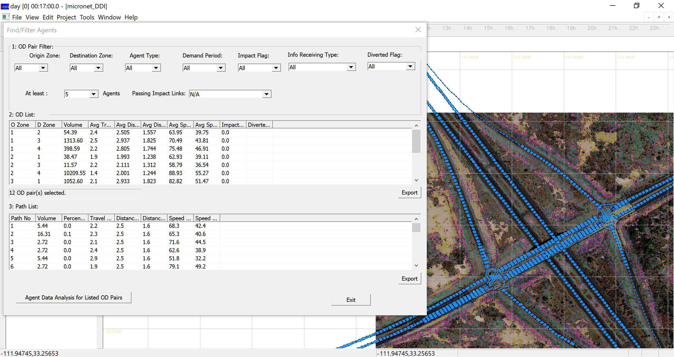
5. Run DTA model using UE assignment mode
output.
5a. link_performance.csv.
5b. od_accessibility.csv
5c. route_assignment.csv
We use analytical queue-based VDF function to produce time-dependent speed, and congestion duration
Visualization in NEXTA

Slide 12
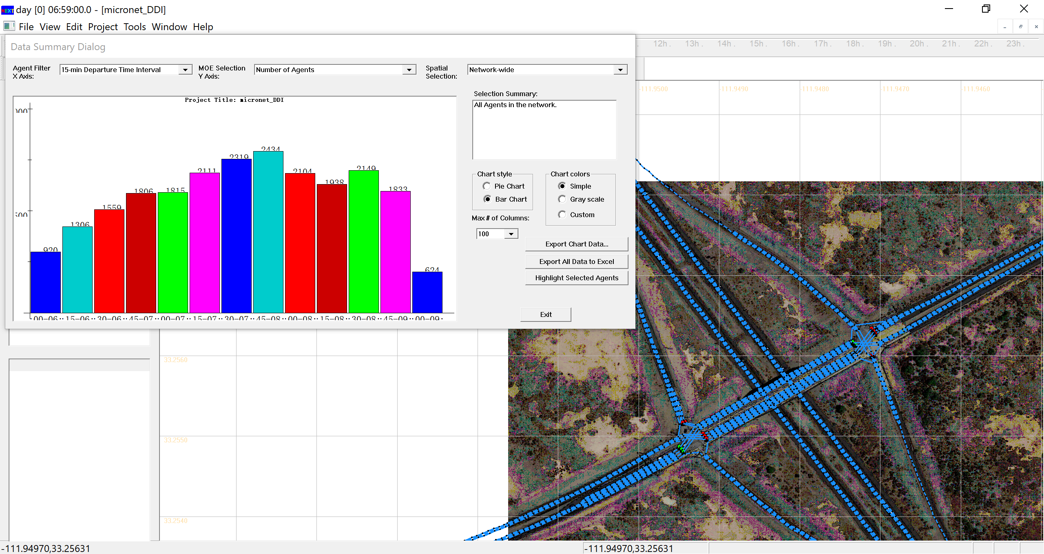
6. Run DTA using simulation mode
Output:
Agent.csv
Trajectory.csv
Visualization in NEXTA

Slide 13
7. Congestion Bottleneck Identification: CBI
The CBI process aims to calibrate the parameters of BPR and QVDF Functions based on the data from all critical links in the network. An effective CBI tool has been embedded into the DTALite package. The outputs are the calibrated parameters for each link with detailed statistics and summary files.
External input sensor file | GMNS input file | Input parameters for DTALite with QVDF
7a. tmc_identification.csv | 7c. link.csv with mapmatched tmc codes, using external mapmatching utility | 7d. cbi_summary.csv
7b. Reading.csv |  | 7e. Cbi_vdf.csv

Slide 14
8. OD demand estimation: ODME
OD-matrix estimation is the estimation of OD matrices by reducing the difference between observed link counts and assigned link volume. The ODME module is also embedded into the DTALite package.
Input | GMNS input file and settings | Output of ODME
8a. Measurement.csv | Node, link | 8c.link_performance.csv with ODME deviation
8b. initial demand file (prepared in step 3) | Settings.csv with ODME iterations | 8d. Route_assignment contains adjusted OD and path volume
8c. check the performance of ODME in the static_link_performance.csv and
8d. obtain the updated OD matrix from od_accessibility.csv.

Slide 15
9. Network design and sensitivity analysis
GMNS input file and settings | Output
9a. Node, link: SA_lanes | 9c.link_performance.csv with ODME deviation
9b. Settings.csv: sensitivity analysis | 9d. Route_assignment contains adjusted OD and path volume
 | 9e. Corriodor.csv sensitivity

Slide 16
10-I. scenario evaluation: workzone and incident
Scenario section in settings.csv.
GMNS input file and settings | Output
10a. Node, link | 10c.link_performance.csv with ODME deviation
10b. Settings.csv: capacity reduction | 10d. Route_assignment contains adjusted OD and path volume

Slide 17
10-II. scenario evaluation: VMS and real time information
Scenario section in settings.csv.
GMNS input file and settings | Output
10a. Node, link Allowed_uses, toll for different time periods | 10c.link_performance.csv with ODME deviation
10b. Settings.csv: VMS | 10d. Route_assignment contains adjusted OD and path volume
 | 10e. Corriodor.csv sensitivity

Slide 18
10-III. scenario evaluation: Tolling
Scenario section in settings.csv.
GMNS input file and settings | Output
10a. Node, link | 10c.link_performance.csv with ODME deviation
10b. Settings.csv: sensitivity analysis | 10d. Route_assignment contains adjusted OD and path volume
 | 10e. Corriodor.csv sensitivity

Slide 19
11. MRM simulation
External input osm file | Zone 2 access step | Output of DTALite
11a.osm pbf file and osm2gmns package | 11e. TAZ.csv (xy coordinate and boundary | 11g. Link performance.csv
11b. Macro node.csv, link.csv, movement.csv | 11f. Zone.csv with zone_id and access_node.csv | 11h. route_assignment.csv for od based travel time statistics
11c. Meso Node.csv, link.csv
11d. Micro node.csv and link.csv

Slide 20
12. MRM signal timing data management
Input | Update movement across resolutions | Output of DTALite simulation
12a. Signal4gmns python package | 12e. Update macro movement using nexta | 12h. route_assignment.csv for od based travel time statistics
12b. Macro node.csv, link.csv, movement.csv | 12f. Regenerate meso and micro network | 12i. Trajectory.csv
12c. Meso Node.csv, link.csv | 12g. Run signal4gmns python package to generate signal timing coded in Meso and micro link.csv
12d. Micro node.csv and link.csv

Slide 21
13. Subarea cut approach
Please use external packages such as cube or TransCAD for this step.
Input |  | Output of DTALite assignment simulation
13a. Subarea boundary | 13d. Subarea cut Node.csv Link.csv | 13h: link_performance.csv
13b. Macro planning network node.csv, link.csv, movement.csv | 13e. Subarea zone.csv | 13i. route_assignment.csv for subarea od based travel time statistics
13c. OD demand from the entire network | 13f: subarea od demand file | 13j. Trajectory.csv

Slide 22
14. Subarea A+B=C enhancing approach
Input |  | Output of DTALite simulation
14a. Subarea boundary | 14d. Integrated Node file With planning network | 14f. route_assignment.csv for od based travel time statistics
14b. Macro planning network node.csv, link.csv, movement.csv | 14e. Integrated link file | 14h. Trajectory.csv
14c. Micro node.csv and link.csv

Slide 23
15. Transit network building
GTFS Input | Physical network | Service network
15a. routes.txt, trips.txt, stops.txt, stop_time.txt | 15d. Integrated Node file With planning network | 15f. route_assignment.csv for od based travel time statistics
15b. Macro planning network node.csv, link.csv, movement.csv | 15e. Integrated link file | 15h. Trajectory.csv
15c. Micro node.csv and link.csv
gtfs2gmns package can convert GTFS data to GMNS network.

Slide 24
16. Transit accessibility evaluation and assignment
GTFS Input | Intermediate zone2stop Output | Assignment results
16a. Zone.csv with centers of zone boundarys from TAZ.csv or census | 16d. Access_link.csv | 16e. Link_performance
16b.node.csv, link.csv |  | 16f. Od_accessibility
16c. Access distance settings.csv |  | 16g. Route_assignment

Slide 25
17. Map matching
Input | Intermediate zone2stop Output | Assignment results
17a. Zone.csv with centers of zone boundarys from TAZ.csv or census | 17d. Access_link.csv | 17e. Link_performance
17b.node.csv, link.csv |  | 17f. Od_accessibility
17c. Access distance settings.csv |  | 17g. Route_assignment

Slide 26
Thank you!
ASU Transportation+AI team

